Slide 1



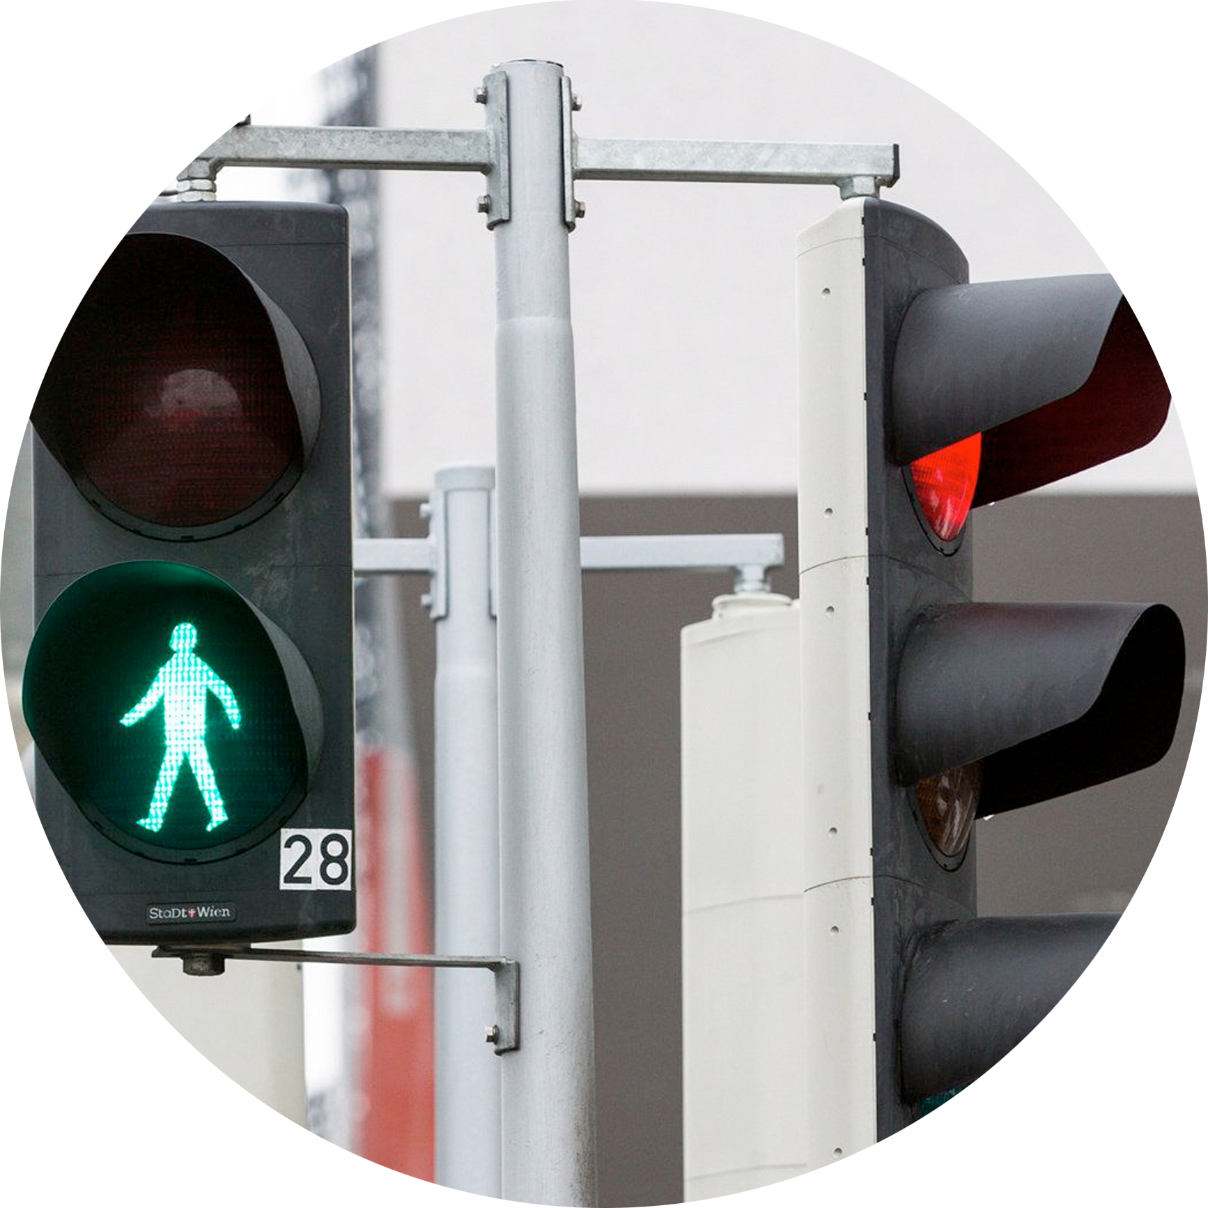



IoT Application System
Smart lights
Smart traffic controller project

Slide 2


Smart lights
Team contribution
SHOKHZODBEK
12200295 (Team leader, Presenter)
NOZIMJON
12204507 (Facilitator and recorder)
SHAKHZODBEK
12200293 (Survayer)
MIRJAVKHARBEK
12214737 (Developer)
MARC
12235365 (Developer
BAKHTIYORJON
12200288 (Developer)

Slide 3

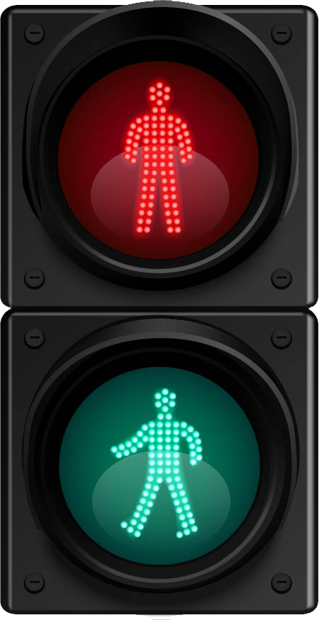



Project background
MAIN CONCEPT
The Smart Traffic Light integrates Raspberry Pi, OpenCV, and YOLO camera modules to revolutionize traffic management. Using real-time object detection, it dynamically adjusts signal timings for both cars and pedestrians, optimizing traffic flow.
This innovative system harnesses cutting-edge technology to create a responsive, efficient, and adaptive traffic control solution for modern urban environments.

Slide 4
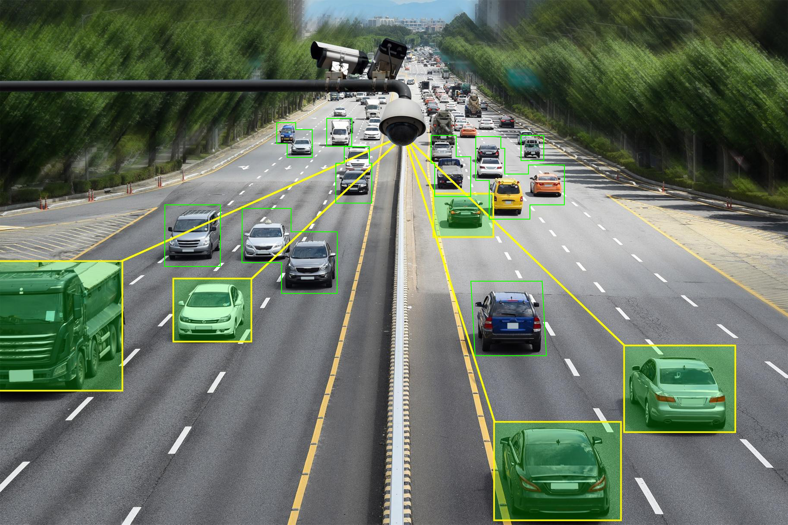
Identified Challenge
Traditional traffic lights suffer from static timings that fail to adjust to fluctuating traffic loads. This rigidity leads to congestion during peak hours and underutilization during low traffic times, causing delays, frustration, and heightened accident risks.
An adaptive and intelligent traffic control system is crucial to address these inefficiencies.

Slide 5
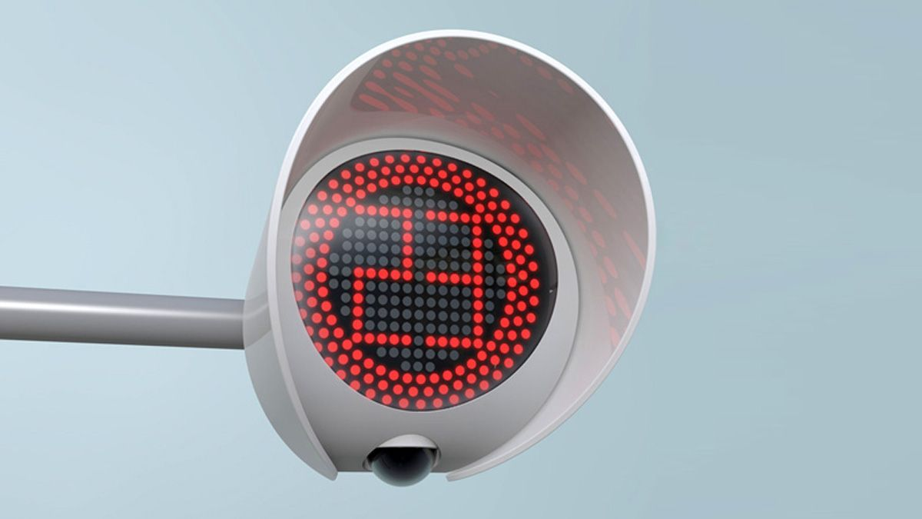

Solutions
Smart Traffic Lights:
Implement an intelligent traffic light system using sensors and machine learning algorithms to dynamically adjust signal timings based on real-time traffic conditions.
Integrated Transportation Systems:
Create a cohesive infrastructure connecting traffic lights, public transportation, and emergency services. Utilize data analytics to optimize traffic flow and enhance overall urban mobility.

